Slide 1
Predicting Canadian Food Prices
Patrick Walter

Slide 2
Background: Canada’s Food Price Report
This year the 8th edition of Canada’s Food Price Report was published as a collaborative effort between Dalhousie University and University of Guelph.
The report looks at factors that affect the future prices seen by consumers for food over the next 12-month period.
Includes the key drivers of the upcoming year’s food prices such as Climate, Energy Costs, Inflation, Policy Context, Food Processing Industry, Consumer Debt and Deleveraging and many more.
The report divides the CPI basket into food categories including Dairy and Eggs, Fruit and Nuts, Meats, Vegetables, and Fish and Seafood.
Notes:
So I will start with the background of this research. This research is based off work done for Canada’s Food Price Report.
2018 marks the 8th year that this report has been published. I began at the university of guelph and is now published here at dalhousie.
The main goal of the report is to be a tool used to look at the factors that are expected to affect the future of food prices seen by Canadian consumers over the next on year period. In the 2018 report some of these key drivers for the upcoming year’s food prices include climate, energy costs, inflation, policy context, food processing industry, consumer debt and deleveraging and many more. The report not only makes predictions of the overall price of food, but also looks at different food categories as they often are effected by different factors and therefore may see different changes.

Slide 3
Background: Consumer Price Index
An indicator of the changes in prices experienced by Canadians, obtained by comparing the rising or falling cost of a fixed basket of good and services.
Fixed basket means that products and services are of the same quality and quantity and therefore these changes in cost are a true reflection of the pure price changes.
Data is released monthly and open to the public on Statistics Canada’s website as part of the CANSIM database.
Notes:
DATA IS STOED IN THE CANSIM DATABASE: THE CANADIAN SOCIOECONOMICAL DATABASE BY STATISTIC CANADA
Able to “slice” or “drill-down” the data to specific products or a variety of aggregates.
Great user interface.

Slide 4
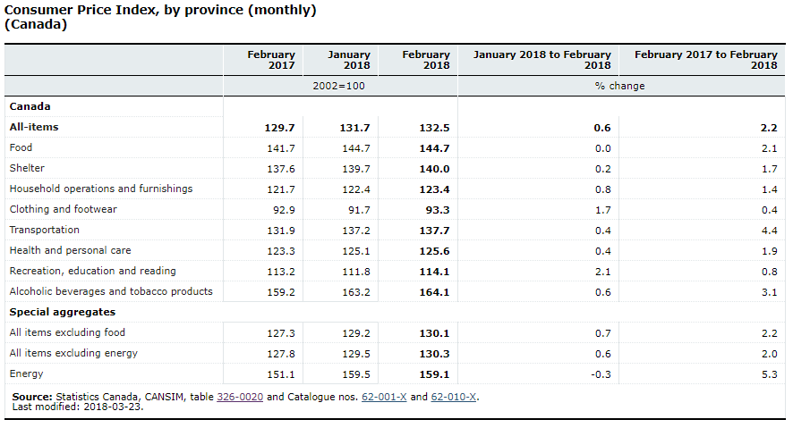
Background: Consumer Price Index
Notes:
So here is sort of the main default display of the monthly cpi on statistics Canada’s website. The basket is divided into each of these general categories. But we can also look at these national numbers and see that the price changes between the different products can be extremely different. If we look at the febuary 2017 to febuary 2018, transporation rose 4.4% while clothing and footwear only grew .4%.. So the main idea of this research and the food report is looking specifically at the food price. So here we see the average food price. We can drill down or slice this catergoies, the statscan site works really easy for this allowing for really precise

Slide 5
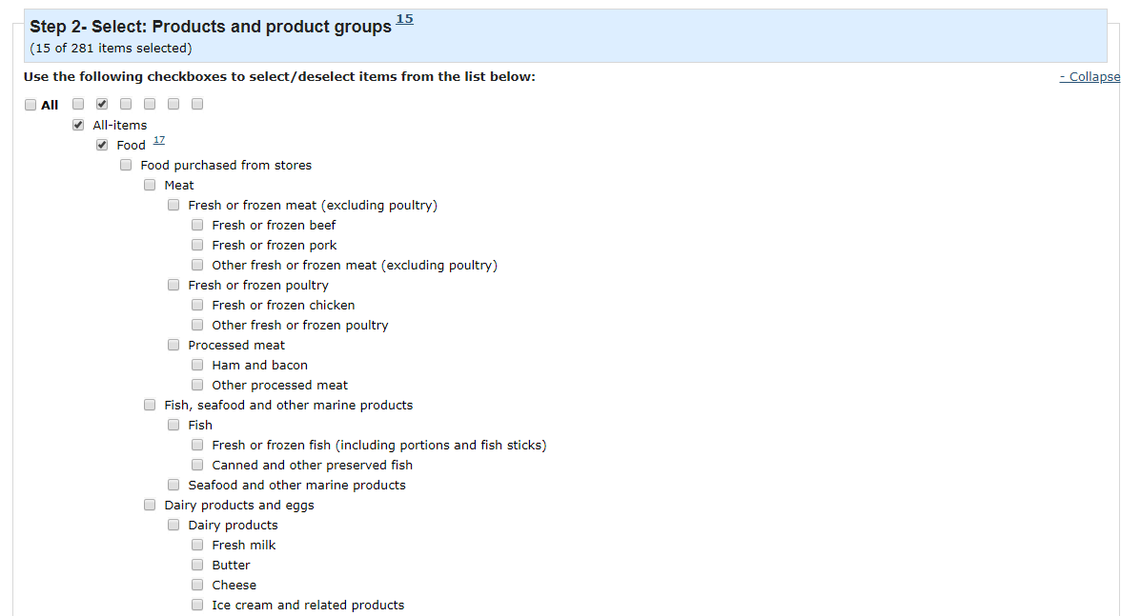
Background: Consumer Price Index
Notes:
SO here we see how we can query the data on statscan. This is just a small portion of the total list of different food products and dfferent aggregates of food products. The list in total has some 50 different bullets. SO there are lots of different targets.
A QUICK EXAMPLE OF SOME DRILL DOWN QUERIES. FOR SOMETHING WE ALL CARE ABOUT.

Slide 6
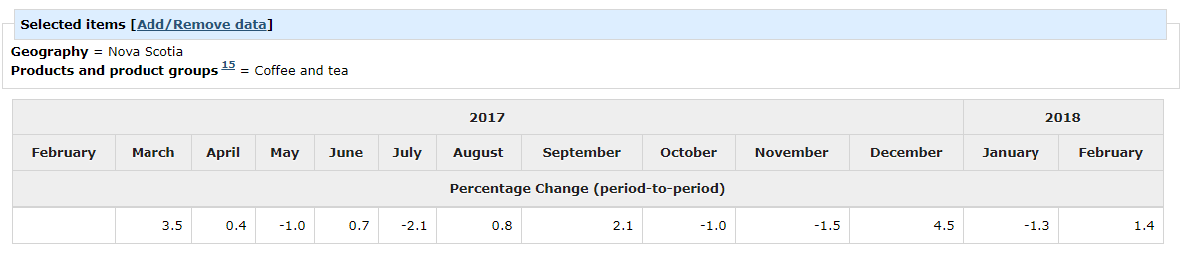
Background: Consumer Price Index

Slide 7
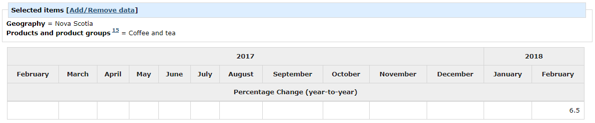
Background: Consumer Price Index

Slide 8
Research Objectives
Train and test predictive models for predicting the average national food price as reported by the CPI for a twelve month period for 5 years, from 2012 to 2016.
Train and test predictive models for predicting 21 other targets in the CPI basket for the years 2016 and 2017.
Gain insight on what years were difficult to predict, and what products were difficult to predict.
Notes:
SO I SET OUT TO ACHIEVE A FEW SIMPLE TASKS OR EXPERIMENTS.
I AM HOPING TO DO SOME LESS NOVEL EXPERIMENTS IN THE FUTURE
BUT SO FAR WHAT I DID WAS :
- TRAIN AND TEST MODELS TO PREDICT THE FOOD PRICE FOR A 12 MONTH PERIOD FOR EACH YEAR IN A 5 YEAR PERIOD
- TRAIN AND TEST MODELS TO PREDICT 21 OTHER TARGETS, AGGREGATE AND INDIVIDUAL PRODUCTS IN THE BASKET, MOSTLY WITH THE FOOD HEADING
- THE GOAL OF THESE WAS TO GAIN INSIGHT ON WHAT YEARS ARE HARD TO PREDICTS, AND WHAT PRODUCTS ARE HARD TO PREDICT

Slide 9
Dataset
The original dataset was built by Jay Harris for his work on the 2017 and 2018 Canada Food Price Report and his thesis research titled A Machine Learning Approach to Forecasting Consumer Food Price
It was constructed using a wide range of financial and econometric data from public and private institutions totaling 280 attributes
The data set began at January 1985 with monthly records concluding at August 2017 giving 291 records.
22 targets from the CPI basket, mostly food products.
Notes:
The dataset I started this project with. Was a csv created by jay harris.
CONSTRUCTED FROM A WIDE RANGE OF FINANCIAL AND ECONOMETRIC DATA BOTH FROM BOTH GOVERNMENT AND PRIVATE
ALL OPEN DATA, FREE AND AVAILABLE ONLINE. SO THAT’S GREAT.
THE DATASET BEGINS JAN 1985 AND HAS MONTHLY RECORDS, ENDING AT AUGUST 2017 GIVING 291 RECORDS TOTAL
So the dataset came to me as a big csv file containg both the attributes and targets

Slide 10
Data Preprocessing
Pandas dataframes was used to manipulate the data.
Dataframe is a tabular data structure that has labeled axes.
Dividing the dataset in targets and attributes
Capping the dataset at 1999
Removing any columns that were incomplete
Creating train and test dataframes for each of the five years
Creating dataframes for each of the individual targets
Notes:
DATAFRAME: Two-dimensional size-mutable, potentially heterogeneous tabular data structure with labeled axes (rows and columns). Arithmetic operations align on both row and column labels. Can be thought of as a dict-like container for Series objects.
PANDAS: A data analysis library with easy to use data structures. Such as dataframes.

Slide 11
Tools: Python Scikit Learn
A machine learning library for Python with a wide variety of implementations for popular algorithms.
This research used the ordinary least squares linear regression implementation. Easy to use to train and test linear regression models.
Feature selection, using mutual information and a selector to select the highest scoring features.
Notes:
Scikit learn: very popular library for machine learning, data mining, and predictive analytics in python.
Has a very wide range of implementations of virtually every algorithm and every variant of that algorithm.
Linear regression models are very easy to test and train. Once that data is all pre processed into the correct data structures, here data frames used as numpy like arrays.
Very simple, couple of lines of code for each model.
Used feature selection to select features to reduce the dimensionality of the models.
Feature selection needs a scoring method to calculation the dependence of correlation between a feature and the target.
For this I used a implementation of mutual information. This implementation uses a k nearest neighbours estimation of mutual information.

Slide 12
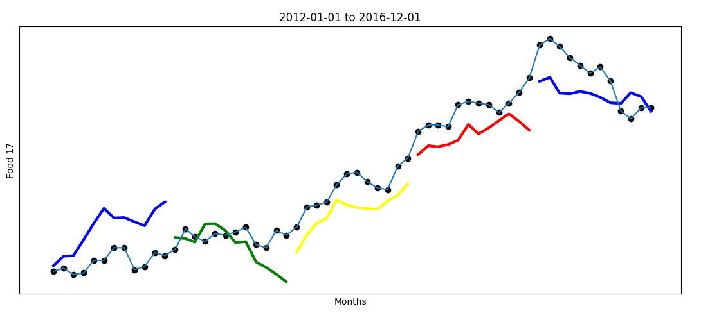
Capturing downward trends, k=25

Slide 13
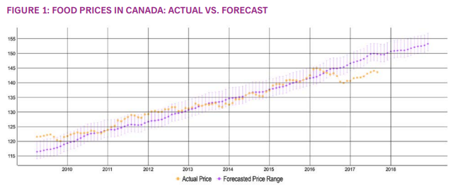
Food Price Report 2018

Slide 14
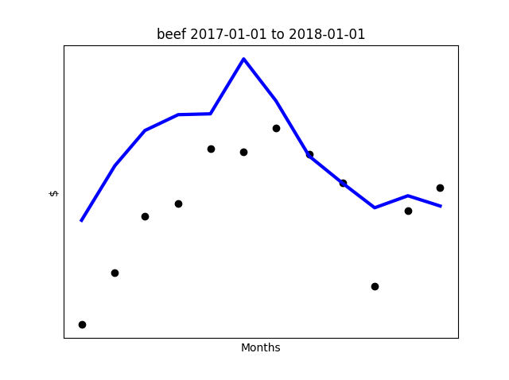
Individual Foods

Slide 15
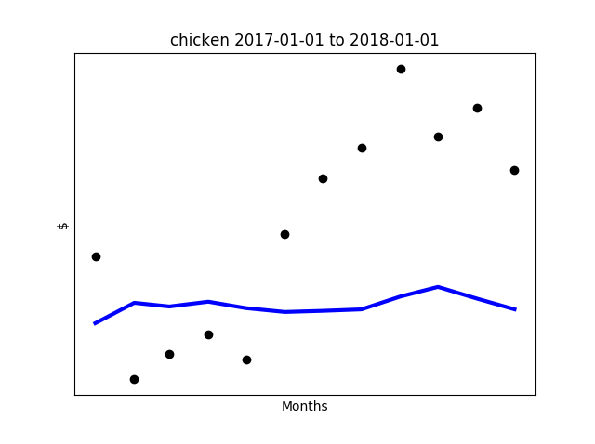
Individual Foods

Slide 16
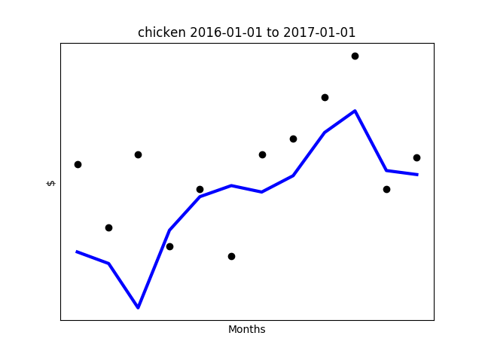
Individual Foods

Slide 17
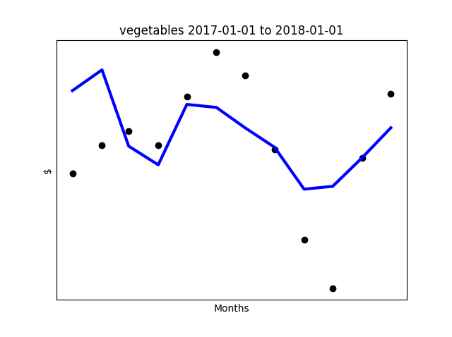
Individual Foods

Slide 18
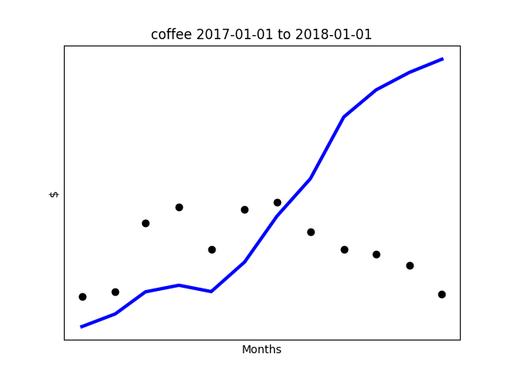
Individual Foods

Slide 19
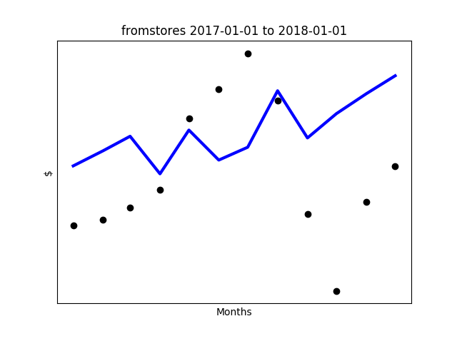
Individual Foods

Slide 20
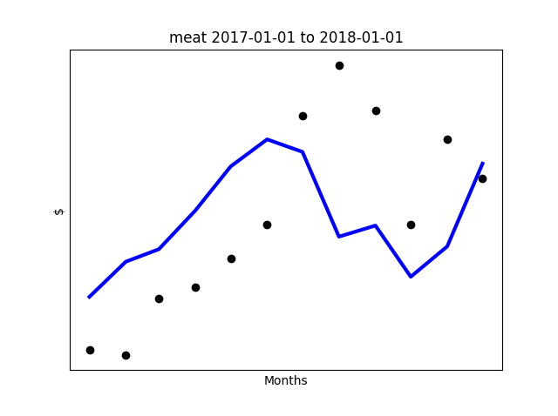
Individual Foods

Slide 21
References
Charlebois, S., Jabez, H., Tyedmers, P., Bailey, M., Keselj, V., Conrad, C., . . . Chamberlain, S. (2017). Canada's Food Price Report. Halifax: Dalhousie University.
Harris, J. (2017, August). A Machine Learning Approach to Forecasting Consumer Food Prices. Halifax, Nova Scotia, Canada.
Hunter, J., Dale, D., Firing, E., & Droettboom, M. (2012). Matplotlib. Retrieved from Matplotlib: https://matplotlib.org/
Kraskov, A., Stögbauer, H., & Grassberger, P. (2004). Estimating Mutual Information. Physical Review, E(69).
Pandas. (2017, December). Python Data Analysis Library. Retrieved from Pandas: https://pandas.pydata.org/
Scikit Learn. (2017). Generalized Linear Models. Retrieved from Scikit Learn: http://scikitlearn.org/stable/modules/linear_model.html
Scikit Learn. (2017). sklearn.feature_selection.mutual_info_regression. Retrieved from Scikit Learn: http://scikitlearn.org/stable/modules/generated/sklearn.feature_selection.mutual_info_regression.html#sk learn.feature_selection.mutual_info_regression
Statistics Canada. (2018, March). Consumer Price Index (CPI). Retrieved from Statistics Cnada: http://www23.statcan.gc.ca/imdb/p2SV.pl?Function=getSurvey&SDDS=2301

